Slide 1
Conformal Prediction

Slide 2




Conformal Framework
DATASET
Point Prediction
CLASSIFIER
ALGORITHM
Accuracy
$$\left(x_{1},y_{1}\right),\left(x_{2},y_{2}\right), . . ., \left(x_{n},y_{n}\right)$$
98%
DATASET
CONFORMAL FRAMEWORK
UNCERTAINTY ESTIMATE
$y_{n+1}$
$$\left(x_{1},y_{1}\right),\left(x_{2},y_{2}\right), . . ., \left(x_{n},y_{n}\right)$$
CLASSIFIER
ALGORITHM
CONFIDENCE
$${(x}_{n+1})$$
CREDIBILITY
Notes:
This is our traditional machine learning and we will see where conformal framework fits and how this can be implemented.
This acts like a wrapper over exiting algorithm and output uncertainty estimate as “confidence” and “credibility”.
Confidence [Model] – We can say that we are 85% confident that the prediction label is A.
Credibility [Data] – It tells about the quality of the data point.

Slide 3

Framework Foundation
Hypothesis Testing
$$L∈\{0, 1\}$$
Algorithmic Randomness
Nonconformity Score
Transductive Inference
Confidence and Credibility
Notes:
This is based on hypothesis testing where we assume a hypothesis for each of the label that the prediction label is H(0) and H(1).
The for each of the hypothesis we computer NCM (similarity between the new data point and the existing dataset) and obtain p-values.
Based on p-values we infer the Confidence and Credibility.

Slide 4
Applications

Slide 5
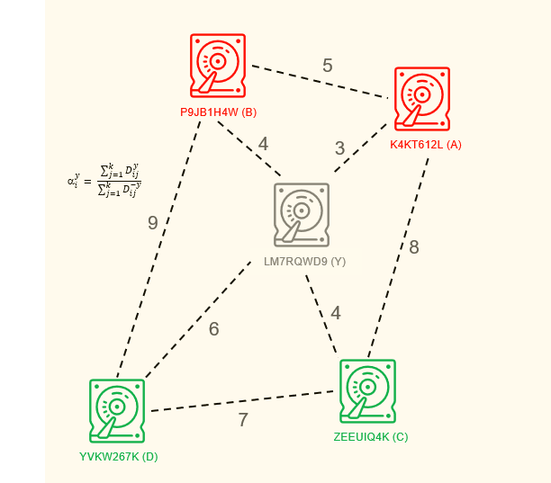
Disk Drive reliability
Given
Disk Drives dataset
Predict
Label of new Disk
Model
K-Nearest Neighbor (k =1)
Uncertainty estimation
Confidence and Credibility

Slide 6
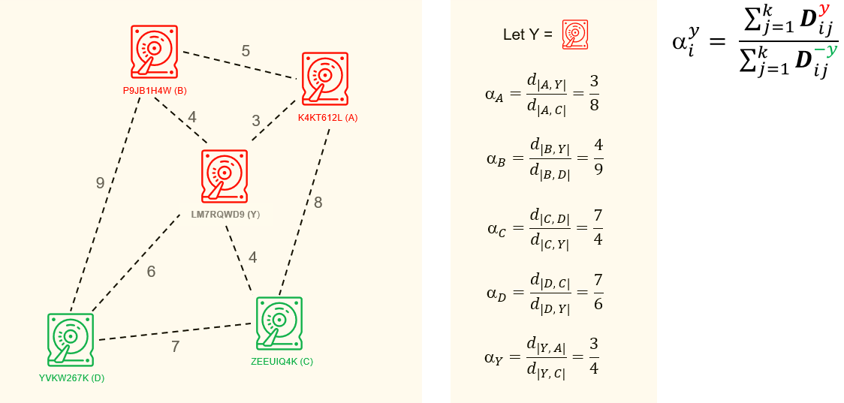
Nonconformity Score
Hypothesis A: Label Failed

Slide 7
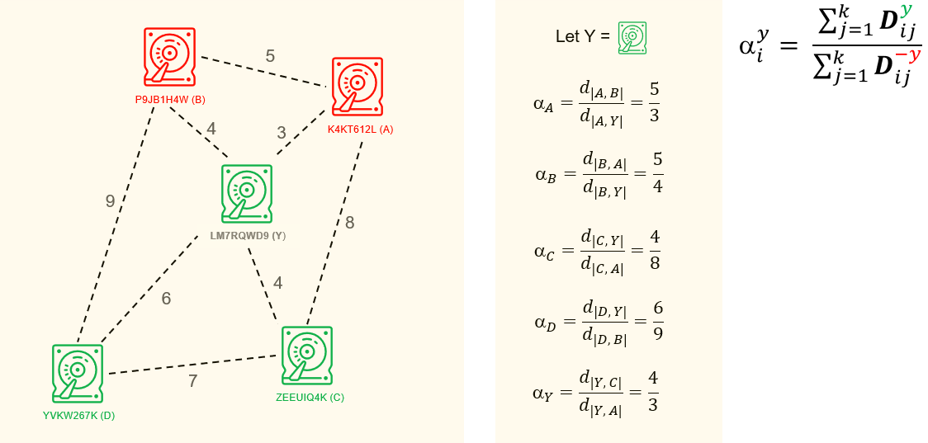
Nonconformity Score
Hypothesis A: Label Normal

Slide 8
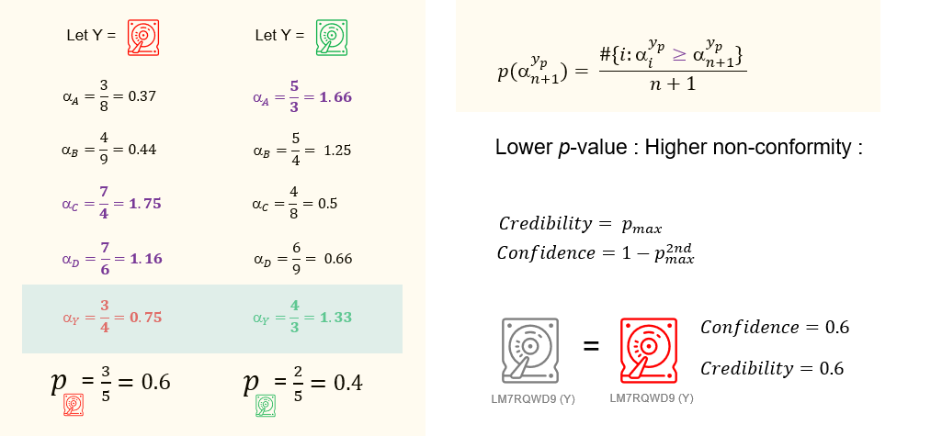
Uncertainty Estimation

Slide 9
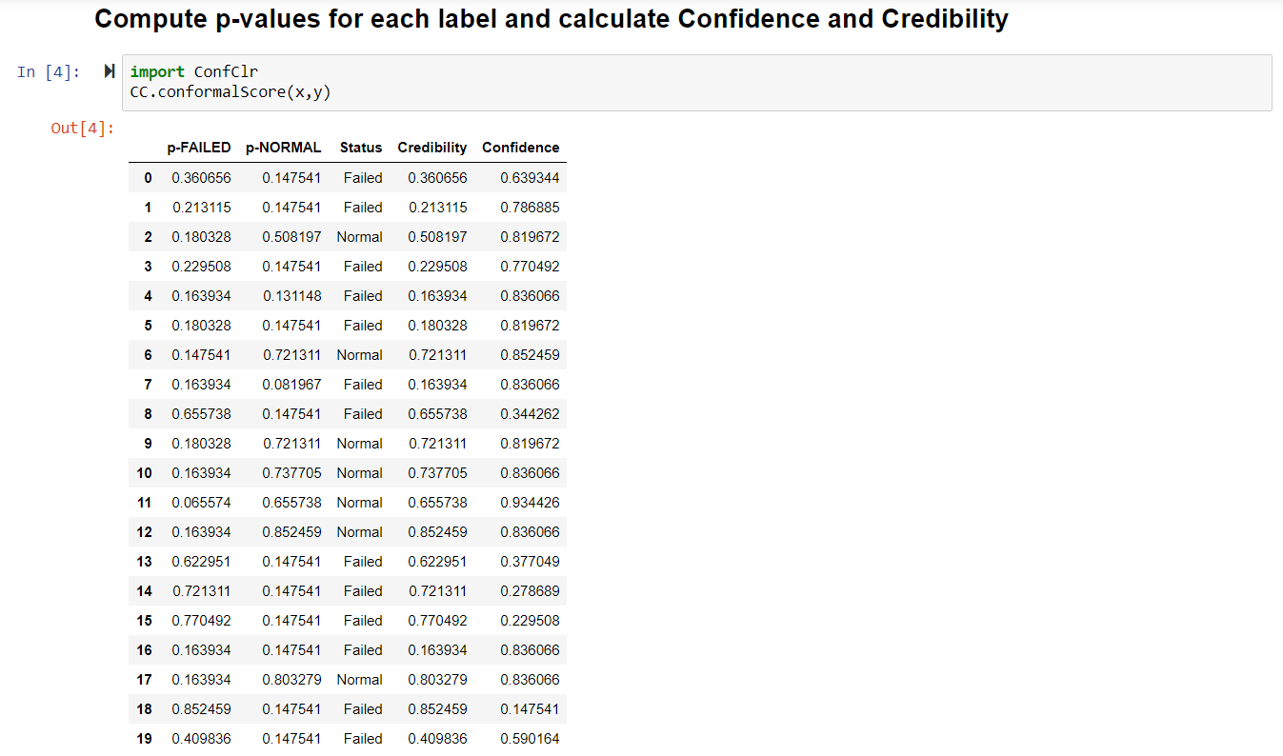
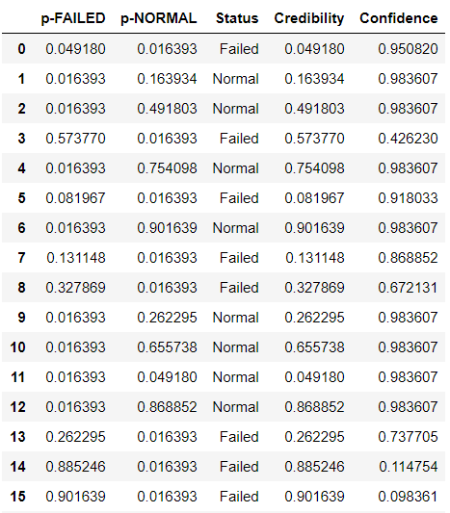
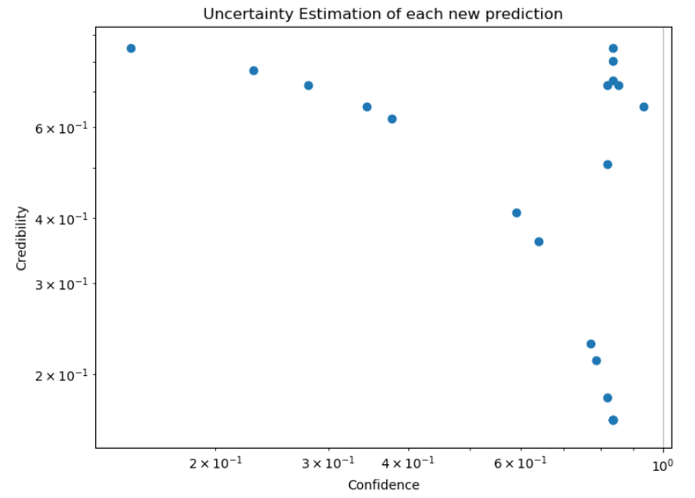
Prediction with Explainable Reliability

